Slide 1
Comparison and usage of RCNN and YOLO
Stefano Ruggiero

Slide 2
Goal of the project (at the and)
Compare the state of art for object detection;
Analyze the tools to use them.

Slide 3
Tools
Detectron2:
RCNN
FASTER RCNN
Ultralytics:
YOLO11
Pythorch, opencv ecc..

Slide 4
Time to run
Let’s go to try the code

Slide 5
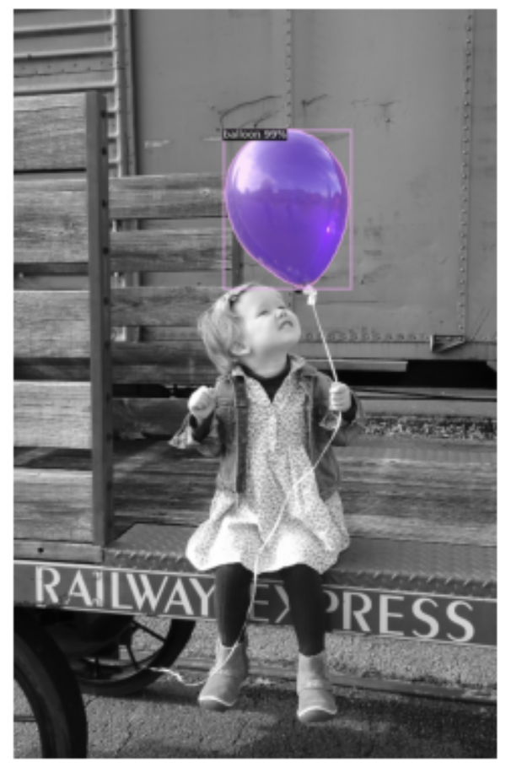
Results – 1 – RCNN segmentation
Bounding box:
'AP': 73.99201924874454,
'AP50': 87.61313821351739,
'AP75': 83.59329701967158,
'APs': 0.0,
'APm': 59.74862344023673,
'APl': 87.75364502442075}
Segment:
'AP': 79.67371020843741,
'AP50': 85.50598828879848,
'AP75': 85.50598828879848,
'APs': 0.0,
'APm': 59.2493551876196,
'APl': 96.77404096684973

Slide 6
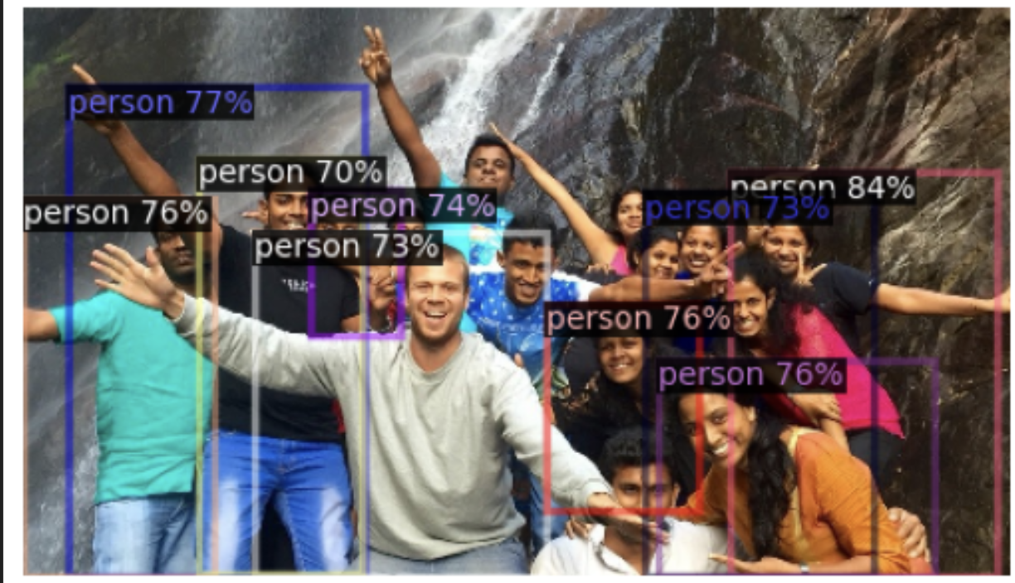
Results – 2 – FASTER RCNN obj detection
'AP': 16.36097941488944,
'AP50': 31.709529334270055,
'AP75': 15.033665037347008,
'APs': 3.171532649694159,
'APm': 14.563460096689202,
'APl': 24.127557824273573

Slide 7
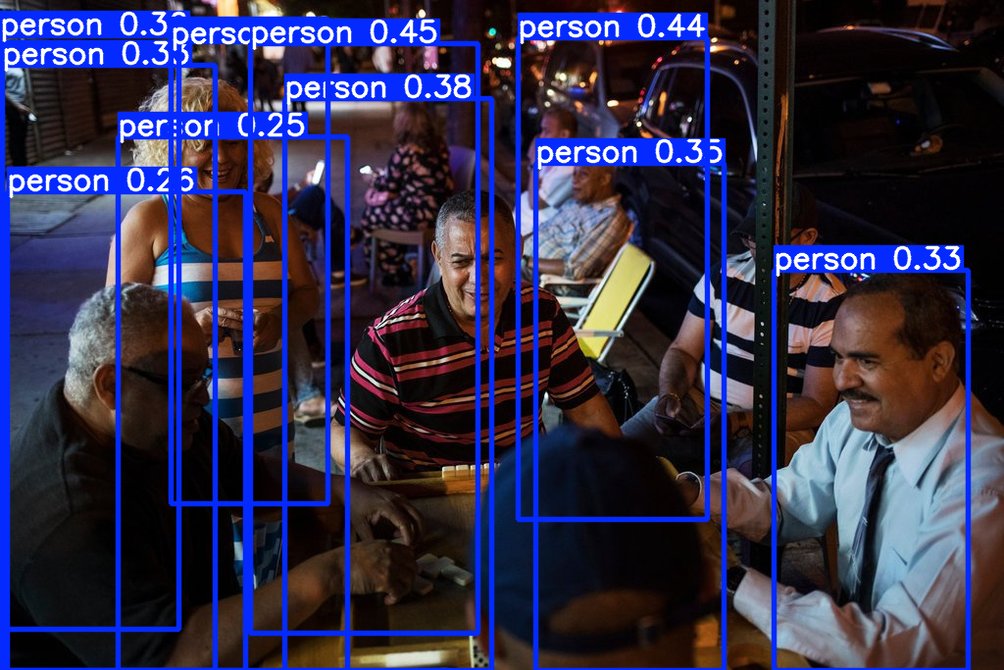
Results – 3 – YOLO obj detection
AP :0.0217

Slide 8
Difficulties
Data are expensive
Harware limits
No standard for datasets
Libraries are not user friendly

Slide 9
Experience
How to use the tools
How to read a dataset
Never give up!

